Slide 1
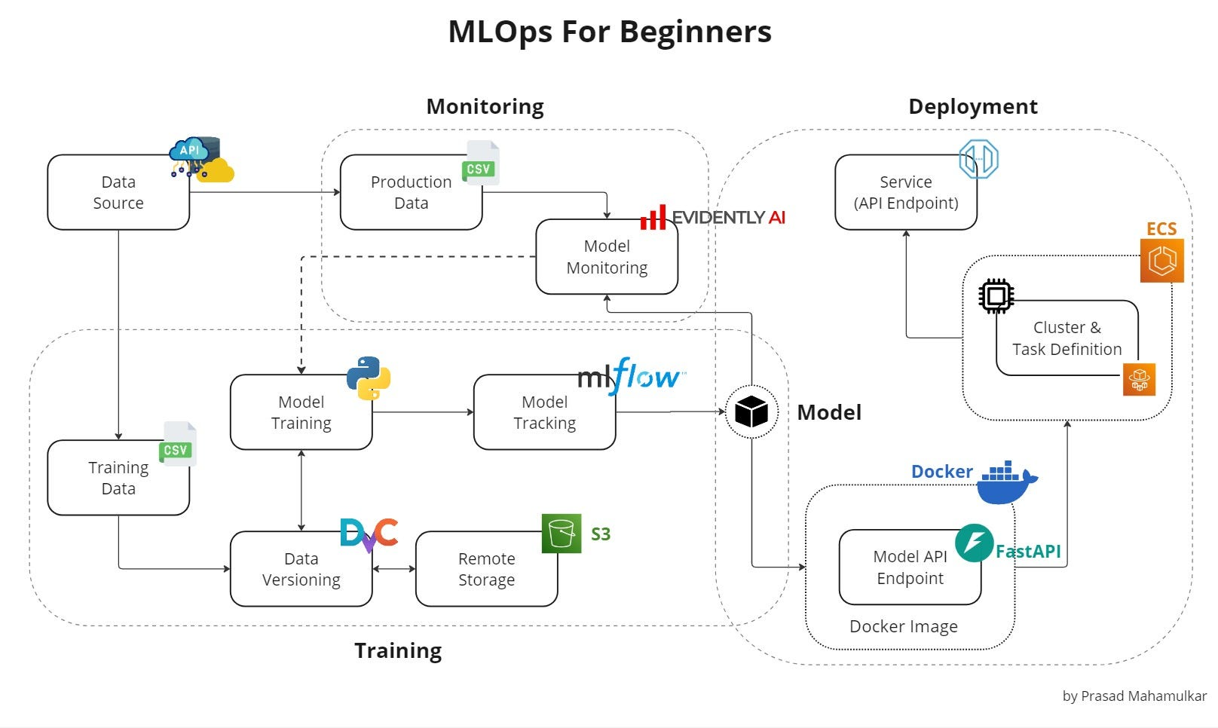
Module 5 – Production Deployment & MLOps
Goal: Packaging and scaling AI systems for the real world.
The Problem: AI environments are fragile. Differences in Python versions, libraries, or GPU drivers can crash a system during deployment.
The Solution: Containerization. We wrap the entire stack—API, Agent logic, and Vector Database—into a single, immutable image.

Slide 2
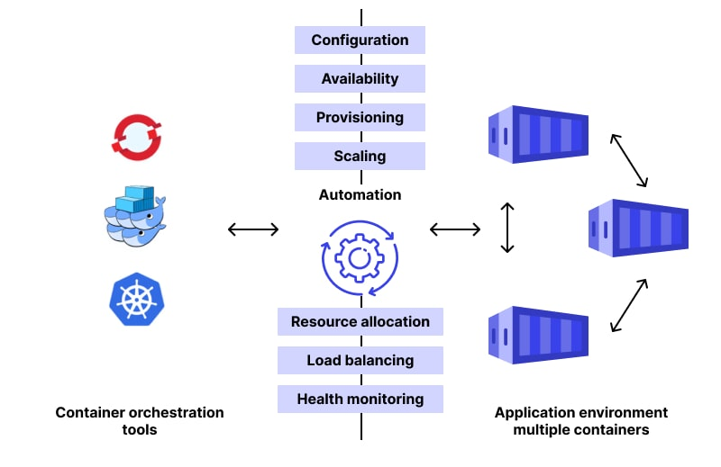
Multi-Container Orchestration
Docker Compose: Managing the "Symphony." In production, your Agent API needs to talk to a Vector DB (like Qdrant or FAISS-Server).
Networking: Docker Compose creates a private virtual network where these services communicate securely without exposing every port to the public internet.

Slide 3
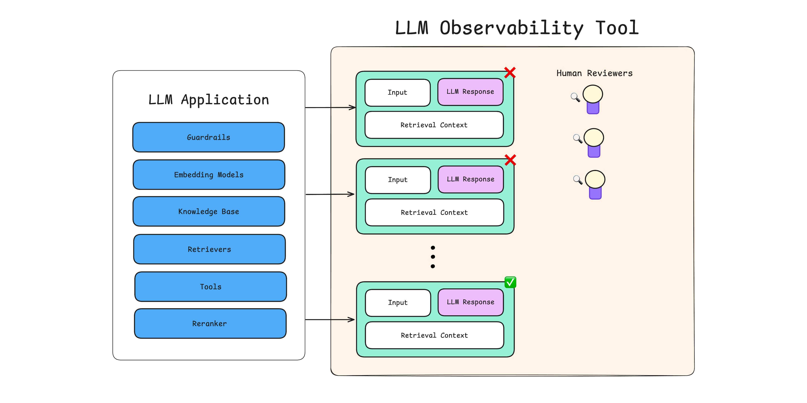
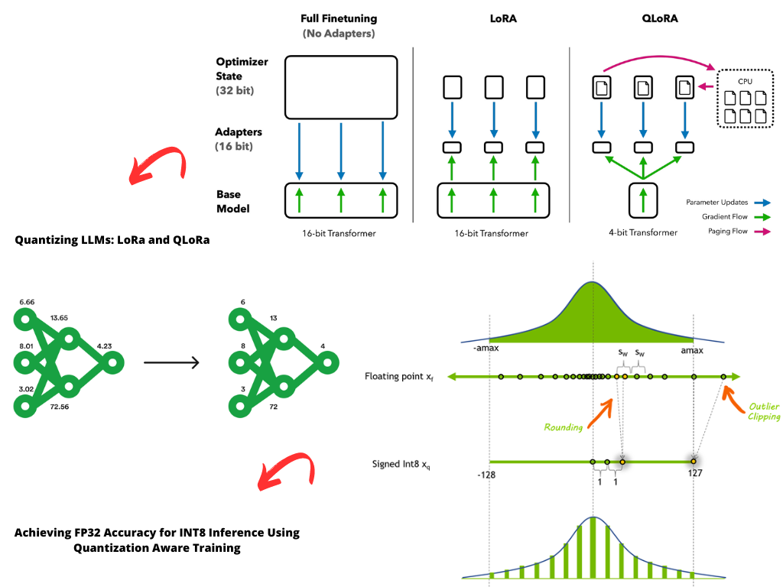
Quantization & Observability
Quantization (GGUF/AWQ): Compressing Large Language Models by reducing the precision of weights (e.g., 16-bit to 4-bit) to enable low-latency hosting on standard hardware.
Observability: Using "Traces" to see exactly which step an agent took before it failed. If an agent enters an infinite loop, observability is your only way to find the "why."
Task 5 Deliverable: A docker-compose.yml that launches your entire Industrial AI system with one command.

